Slide 1
Python Enablement for Gen AI
Ajay J. Singala

Slide 2
Enterprise AI with RAG

Slide 3
RAG Fundamentals & Enterprise Use

Slide 4
Enterprise Challenges
LLMs are powerful,
  But they don’t “know” your enterprise data
  They predict text
Key challenges:
  Hallucination
  Grounding

Slide 5
Enterprise Challenges
Hallucination
  Confidently wrong answers
  Model gives plausible but incorrect answers
  Happens when:
    Data is missing
    Question is ambiguous
    Model relies only on training data
  Example
    Prompt:
    "What is our company’s refund policy for premium customers?“
    LLM (without RAG):
    "Premium customers get full refunds within 60 days“
    (Completely made up)

Slide 6
Enterprise Challenges
Data Grounding
  Reality anchoring
  Ensuring answers come from trusted enterprise sources
  Like: policies, SOPs, contracts, audit documents
  Same Example with RAG
  LLM (with RAG):
    "As per policy document v3.2, premium customers are eligible for partial refunds within 30 days.“

Slide 7
RAG vs Fine-Tuning (When to Use What)
Simple Analogy
  RAG = Open-book exam
  Fine-tuning = Memory training
RAG (Retrieval-Augmented Generation)
  Fetches latest external data at runtime
  No need to retrain model
  Use RAG when:
    Data changes frequently (policies, pricing, regulations)
    Large document repositories
    Need traceability (citations)
  Example
    Customer support bot pulling answers from:
      Knowledge base
      FAQs
      Policy documents

Slide 8
RAG vs Fine-Tuning (When to Use What)
Fine-Tuning
  Trains model on specific patterns or behavior
  Not ideal for frequently changing data
  Use Fine-tuning when:
    You want:
      Consistent tone (e.g., legal, brand voice)
      Structured outputs
      Domain-specific reasoning
  Example
    Training model to:
      Write audit summaries in a specific format
      Classify insurance claims

Slide 9
RAG vs Fine-Tuning (When to Use What)
Simple Comparison
Factor | RAG | Fine-Tuning
Data freshness | Real-time | Static
Cost | Lower | Higher
Explainability | High (sources) | Low
Setup time | Faster | Slower
Best for | Knowledge retrieval | Behavior shaping

Slide 10
RAG Pipeline
Big Picture
  RAG = Search + Generate
Steps:
  Ingestion
  Chunking
  Embeddings
  Retrieval
  Generation

Slide 11
RAG Pipeline
1. Ingestion
  The process of collecting, cleaning, and preparing enterprise data before it enters the RAG pipeline.
  Why Ingestion Matters
    If ingestion is poor:
      Wrong documents enter the system
      Outdated data gets used
      Sensitive data may leak
    Result: Garbage in → Garbage out
  What Happens in Ingestion?
    Data Source Identification (where does data come from?)
    Data Extraction
    Data Cleaning
    Metadata Enrichment
    Access Control & Security
    Data Freshness & Updates

Slide 12
RAG Pipeline
2. Chunking
  Break large documents into smaller pieces
  Example
    100-page policy → split into:
      Sections
      Paragraphs
  Why?
  LLMs can’t process huge documents at once efficiently

Slide 13
RAG Pipeline
3. Embeddings
  Convert text into numerical vectors (meaning representation)
  Example
    “refund policy” and “return rules” → similar vectors
    This allows semantic search, not just keyword search

Slide 14
RAG Pipeline
4. Retrieval
  Find most relevant chunks based on user query
  Example
    Query:
    "What is claim settlement time?"
    System retrieves:
      Clause 4.2 from claims document

Slide 15
RAG Pipeline
5. Generation
  LLM generates answer using:
    Retrieved data
    User query
  Example Output
    "According to Clause 4.2, claim settlement takes 7–10 working days.“

Slide 16
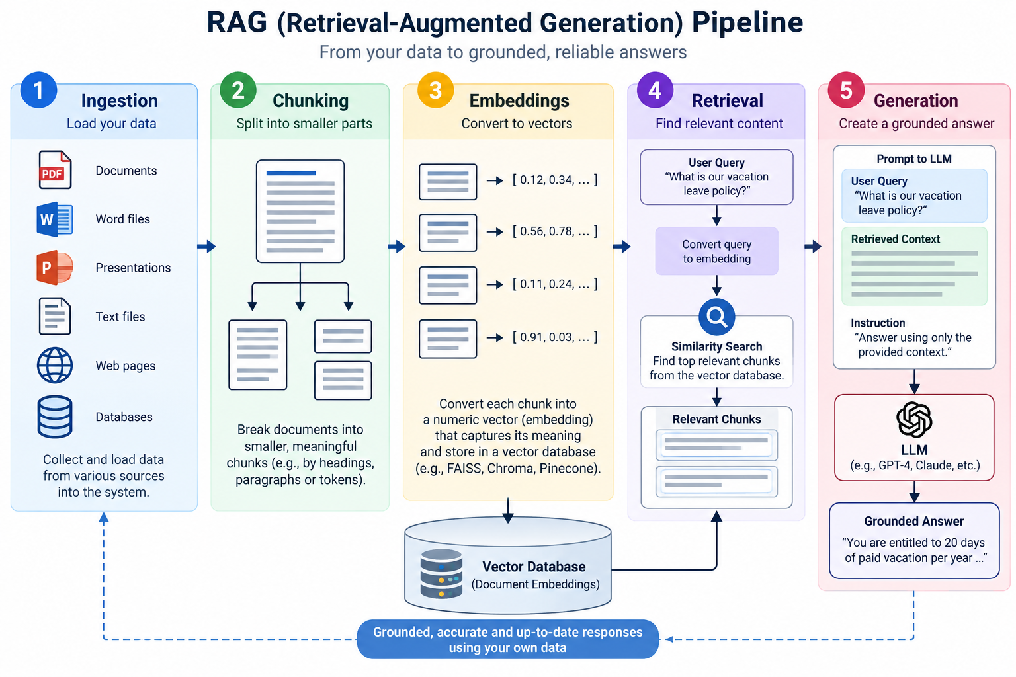

Slide 17
Output Evaluation – Grounded vs Hallucinated
Why it matters
  Even with RAG, AI can still:
    Misinterpret retrieved data
    Combine facts incorrectly
Grounded Response
  Based on retrieved documents
  Includes references
  Example
    "As per HR Policy Section 5.1, employees are eligible for 20 days leave."
    Traceable
    Verifiable
Hallucinated Response
  No source or incorrect interpretation
  Example
  "Employees typically get 25 days leave annually."
    Sounds reasonable
    But not in your policy

Slide 18
Where Latency, Cost, and Quality Degrade
Ingestion Stage
  Latency
    Usually offline → not user-facing
    But slow ingestion = data not available in time
  Cost
    OCR (for scanned PDFs)
    Data pipelines
    Storage (documents + vectors)
  Quality Risks
    Poor extraction (missed tables, clauses)
    Duplicate or outdated documents
    Missing metadata
  Example:
    Contract clause not extracted properly → never retrieved later

Slide 19
Where Latency, Cost, and Quality Degrade
Chunking Stage
  Latency
    Minimal impact during runtime
    But affects retrieval efficiency
  Cost
    More chunks = more embeddings = higher cost
  Quality Risks
    Too Large Chunks:
      Irrelevant content included
      Lower retrieval precision
    Too Small Chunks:
      Loss of context
      Fragmented answers
  Example:
    Chunk = full 10-page policy → noisy retrieval
    Chunk = 1 line → missing context

Slide 20
Where Latency, Cost, and Quality Degrade
Embeddings Stage
  Latency
    Happens during ingestion (mostly)
    Query embedding is fast but adds slight delay
  Cost
    Charged per token
    Large document base → significant cost
  Quality Risks
    Poor embedding model → weak semantic understanding
    Domain mismatch (e.g., legal vs general embeddings)
  Example:
    “Penalty clause” not matched with “liquidated damages”

Slide 21
Where Latency, Cost, and Quality Degrade
Retrieval Stage (Most Critical)
  Latency
    Vector search + filtering
    Complex queries → slower retrieval
  Cost
    Large vector DB → infra cost
    Hybrid search (keyword + vector) adds cost
  Quality Risks (BIGGEST IMPACT)
    Wrong chunks retrieved
    Relevant chunks missed
    Too many chunks retrieved (noise)
  Example:
    User: “What is the audit escalation process?”
      Retrieved: audit definition
      Should retrieve: escalation SOP

Slide 22
Where Latency, Cost, and Quality Degrade
Generation Stage (LLM)
  Latency
    LLM response time (largest contributor)
    More context → slower response
  Cost
    Charged per input + output tokens
    More retrieved chunks → higher cost
  Quality Risks
    Hallucination (if context weak)
    Over-generalization
    Ignoring retrieved content
  Example:
    Correct chunk retrieved, but model adds extra incorrect info

Slide 23
Demo
RAG Pipeline

Slide 24
Thank you

